Slide 1
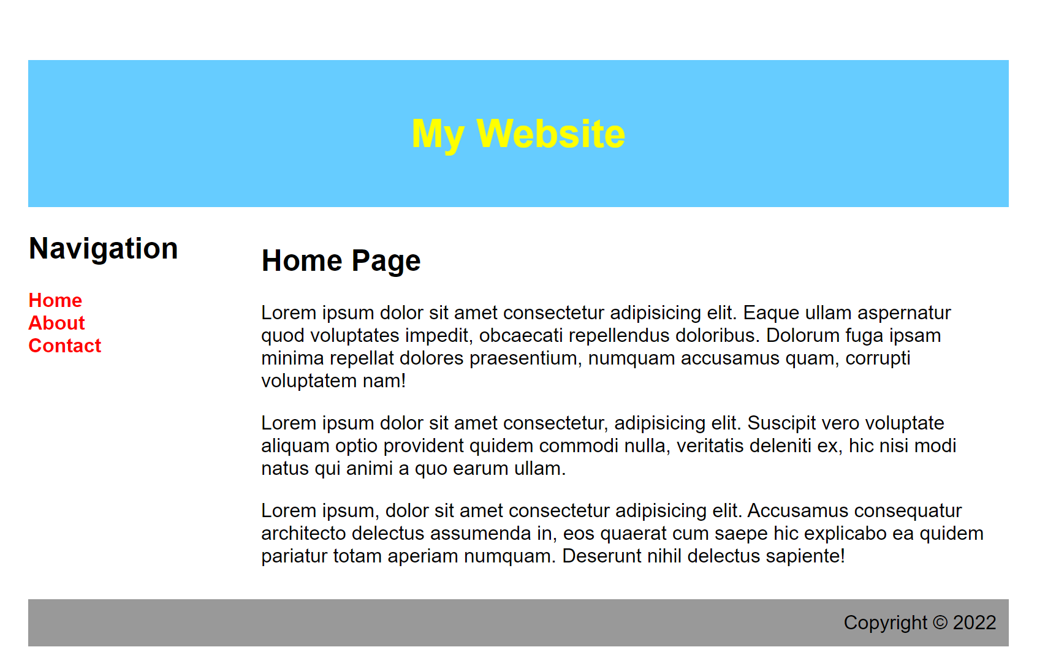
<body>
<header>
<section>
``
``
``
<article>
<nav>
<footer>

Slide 2
Document Object Model
window
document
<html>
<head>
<body>
<div>
<footer>
<header>
<section>
<h1>
<nav>
<article>
<h2>
<ul>
<h1>
<p>
<p>
<p>
<li>
<li>
<li>

